Slide 1
Fellows,
We are so grateful that you are willing to share about your Fund for Teachers fellowship experience and are encouraging your colleagues to apply.
This presentation is customizable for your needs. We feel that sharing your personal fellowship experience is much more valuable than some of the other content. However, eligibility requirements are imperative to share. If you receive questions you don’t feel comfortable answering, please direct your colleagues to the contact information found on the last slide.
Accompanying this slideshow, you will find a copy of our 2024 Application Guidelines and Scoring Criteria. The proposal questions are new, so we encourage you to review these details prior to your presentation.
Above all else, we hope you enjoy sharing your unique experience with your peers and school community!
-The team at FFT

Slide 2
GO BEYOND

Slide 3
FFT Fellowship: GO BEYOND
Goals of this Session:
Share my FFT Fellowship Experience
Provide an overview of Fund for Teachers mission and goals for grant recipients
Define eligibility requirements
Note important resources
Questions
“My fellowship was beyond what I even planned to learn.”

Slide 4
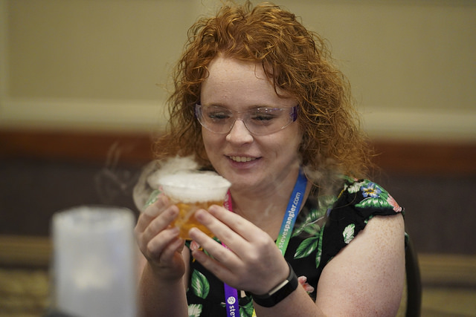
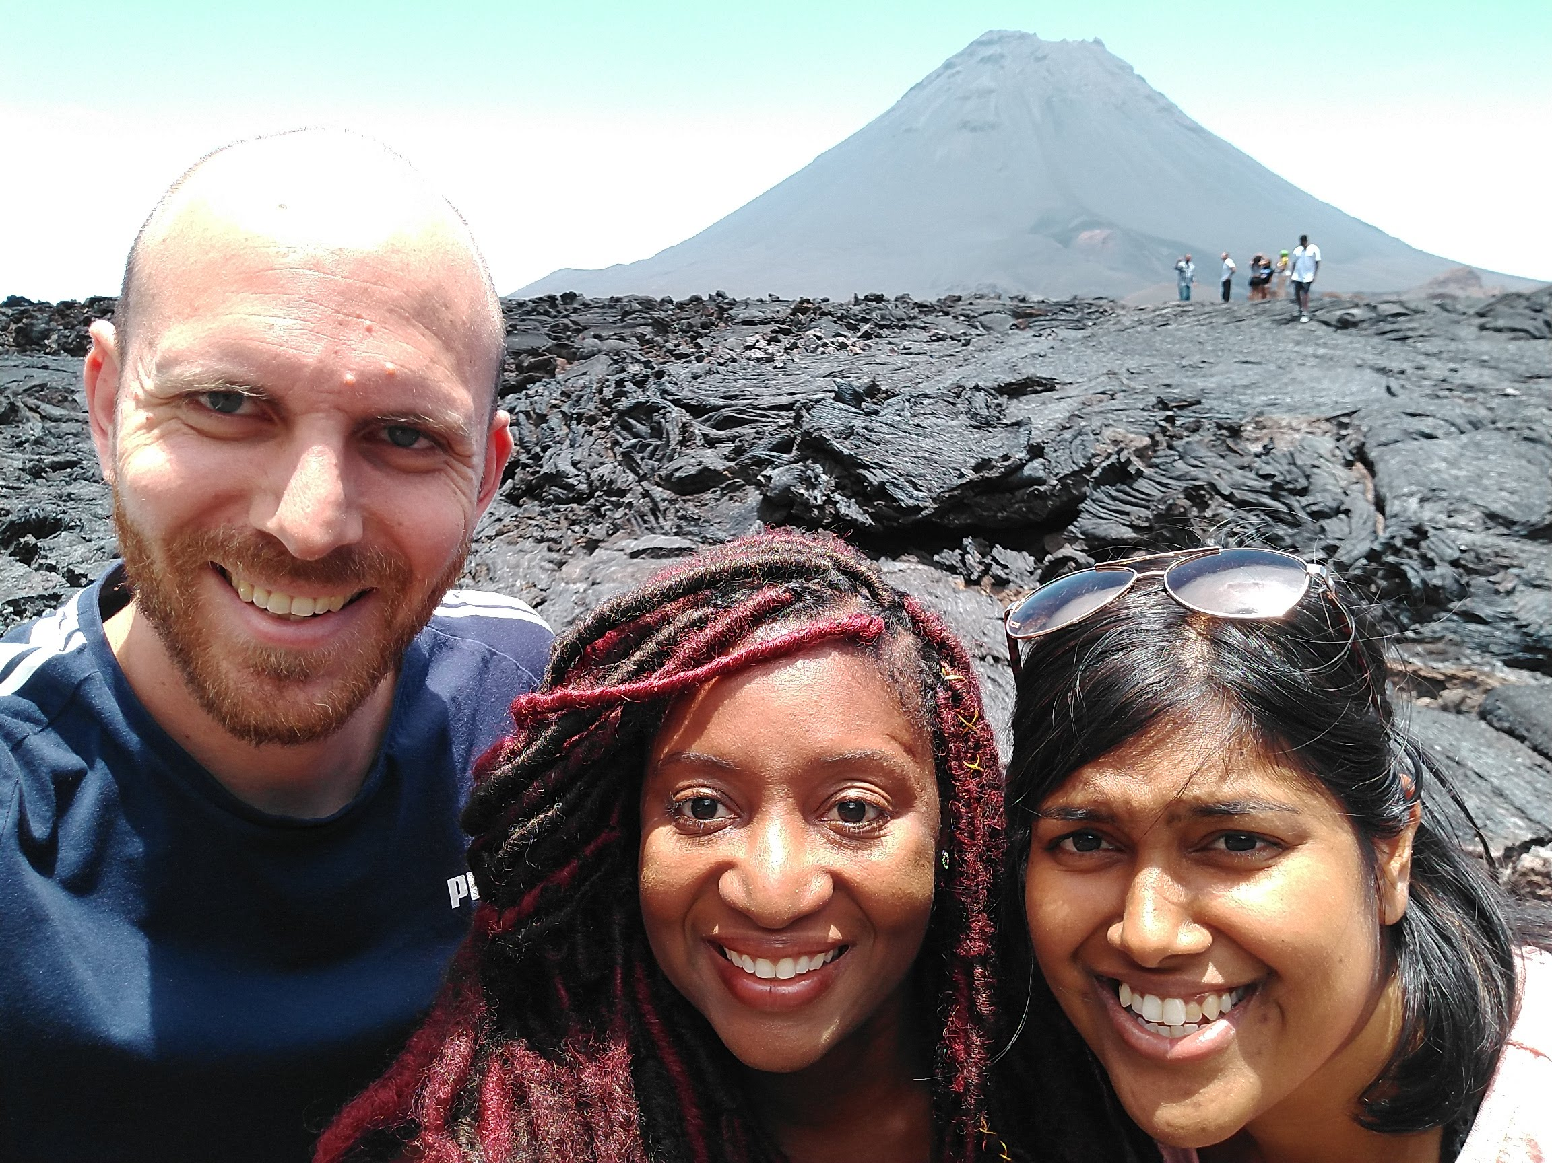
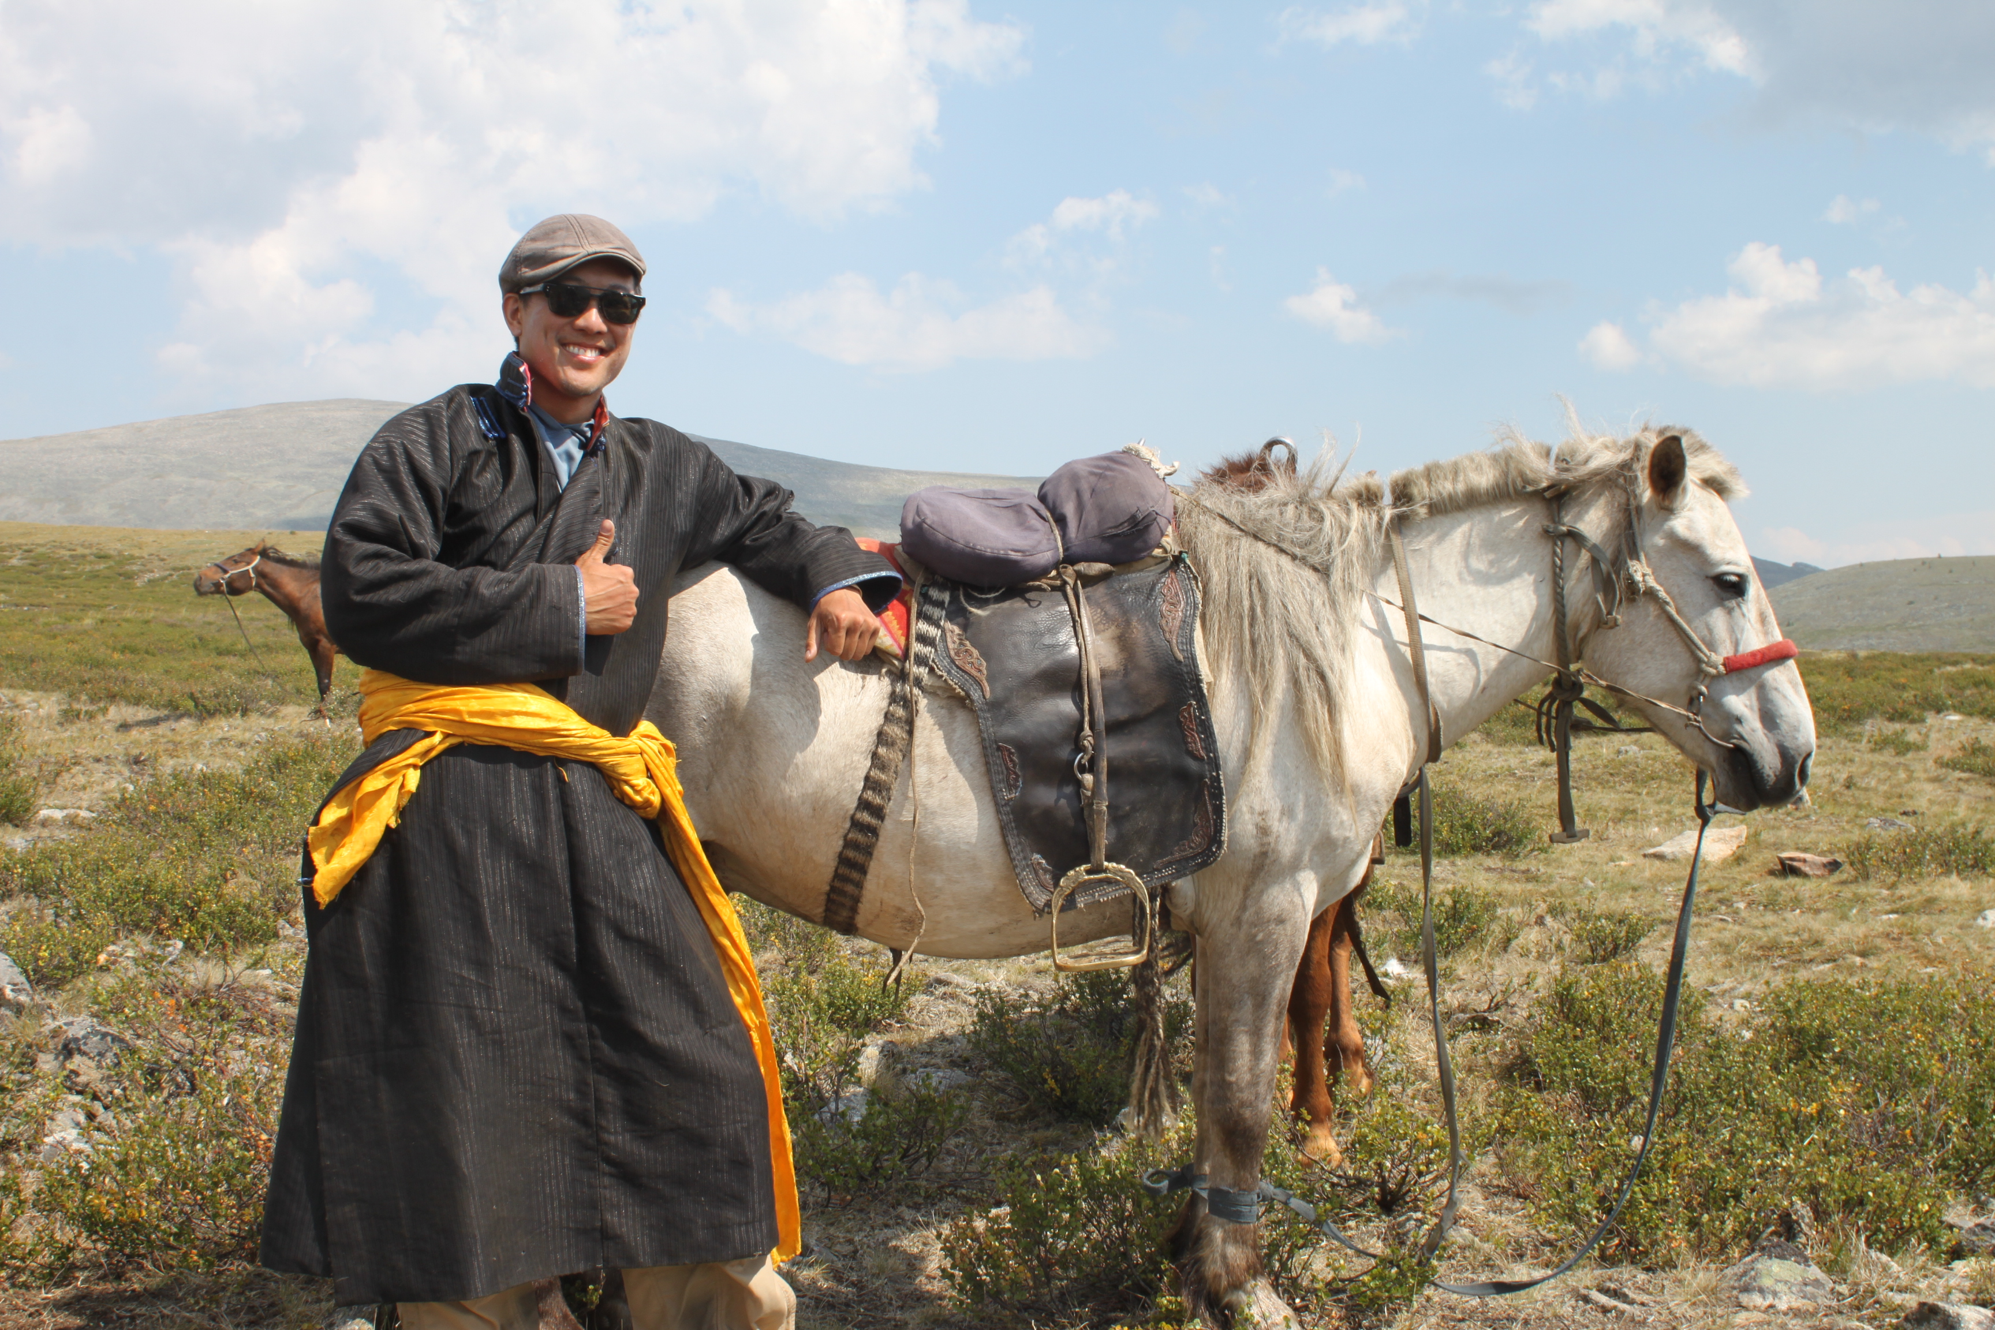
MISSION
INVEST in outstanding teachers' self-determined professional growth and development to support student success, enrich their own practice, and strengthen their schools and communities.
Notes:
Goals of a Fund for Teachers fellowship are for educators to:
serve as problem solvers and innovators who create solutions to real problems of practice;
reflect on their experience as a learner and transfer the most powerful aspects of their experience to student learning;
Integrate their experiences as Fund for Teachers Fellows into their teaching to create more
globally minded students who are empowered to take action;
and grow as leaders and change makers.

Slide 5
ELIGIBILITY
Applicants for a Fund for Teachers Fellowship must meet all the following eligibility requirements. Administrators may not apply, nor may they act as the partner applicant.
FULL TIME
1
2
3-YEARS EXPERIENCE
Applicants must be full-time preK-12th grade teachers who spends at least 50% of your time directly providing instruction to students.
Applicant must have at least three years' experience as a preK-12th grade teacher at the end of this school year.
TEACHING NEXT YEAR
3
4
FIVE YEAR WAITING PERIOD
Applicant must intend to return to the classroom in the consecutive school year.
Previous grant recipients must wait for 5 years before reapplying.
“My experiences went beyond my expectations I proposed in my application.”
Notes:
Not so concerned with your title, but how much time you actively teach students.
Years of experience do not need to be in your current school or district, state or even country.
Student and substitute teaching do not count towards the three-year minimum.
All team members must meet eligibility requirements. Teams do not need to be from the same school, district or even state!

Slide 6
THE FELLOWSHIP
$5,000 for Individuals
$10,000 for Teams of two or more
Projects should take place during the summer; some exceptions are possible. Contact FFT.
Applicants can submit ONE application per grant cycle.
Applications are due January 18 at 5PM Central
See guidelines for project eligibility.
Notes:
Project Eligibility, if you would like to share:
We do not make grants to support student travel, the completion of post baccalaureate degrees, university/college credit hours, courses for graduate credit, licensing, or licensure, onsite (or campus) professional development at your school or by the district, compensation for substitutes, stipends and requests that only include classroom supplies, such as books, technology, or other materials. Grants cannot be used to pay for any portion of National Board Certification. All project eligibility is at the discretion of Fund for Teachers.

Slide 7
MY FELLOWSHIP EXPERIENCE

Slide 9
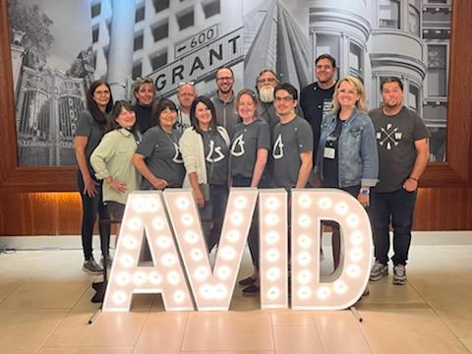
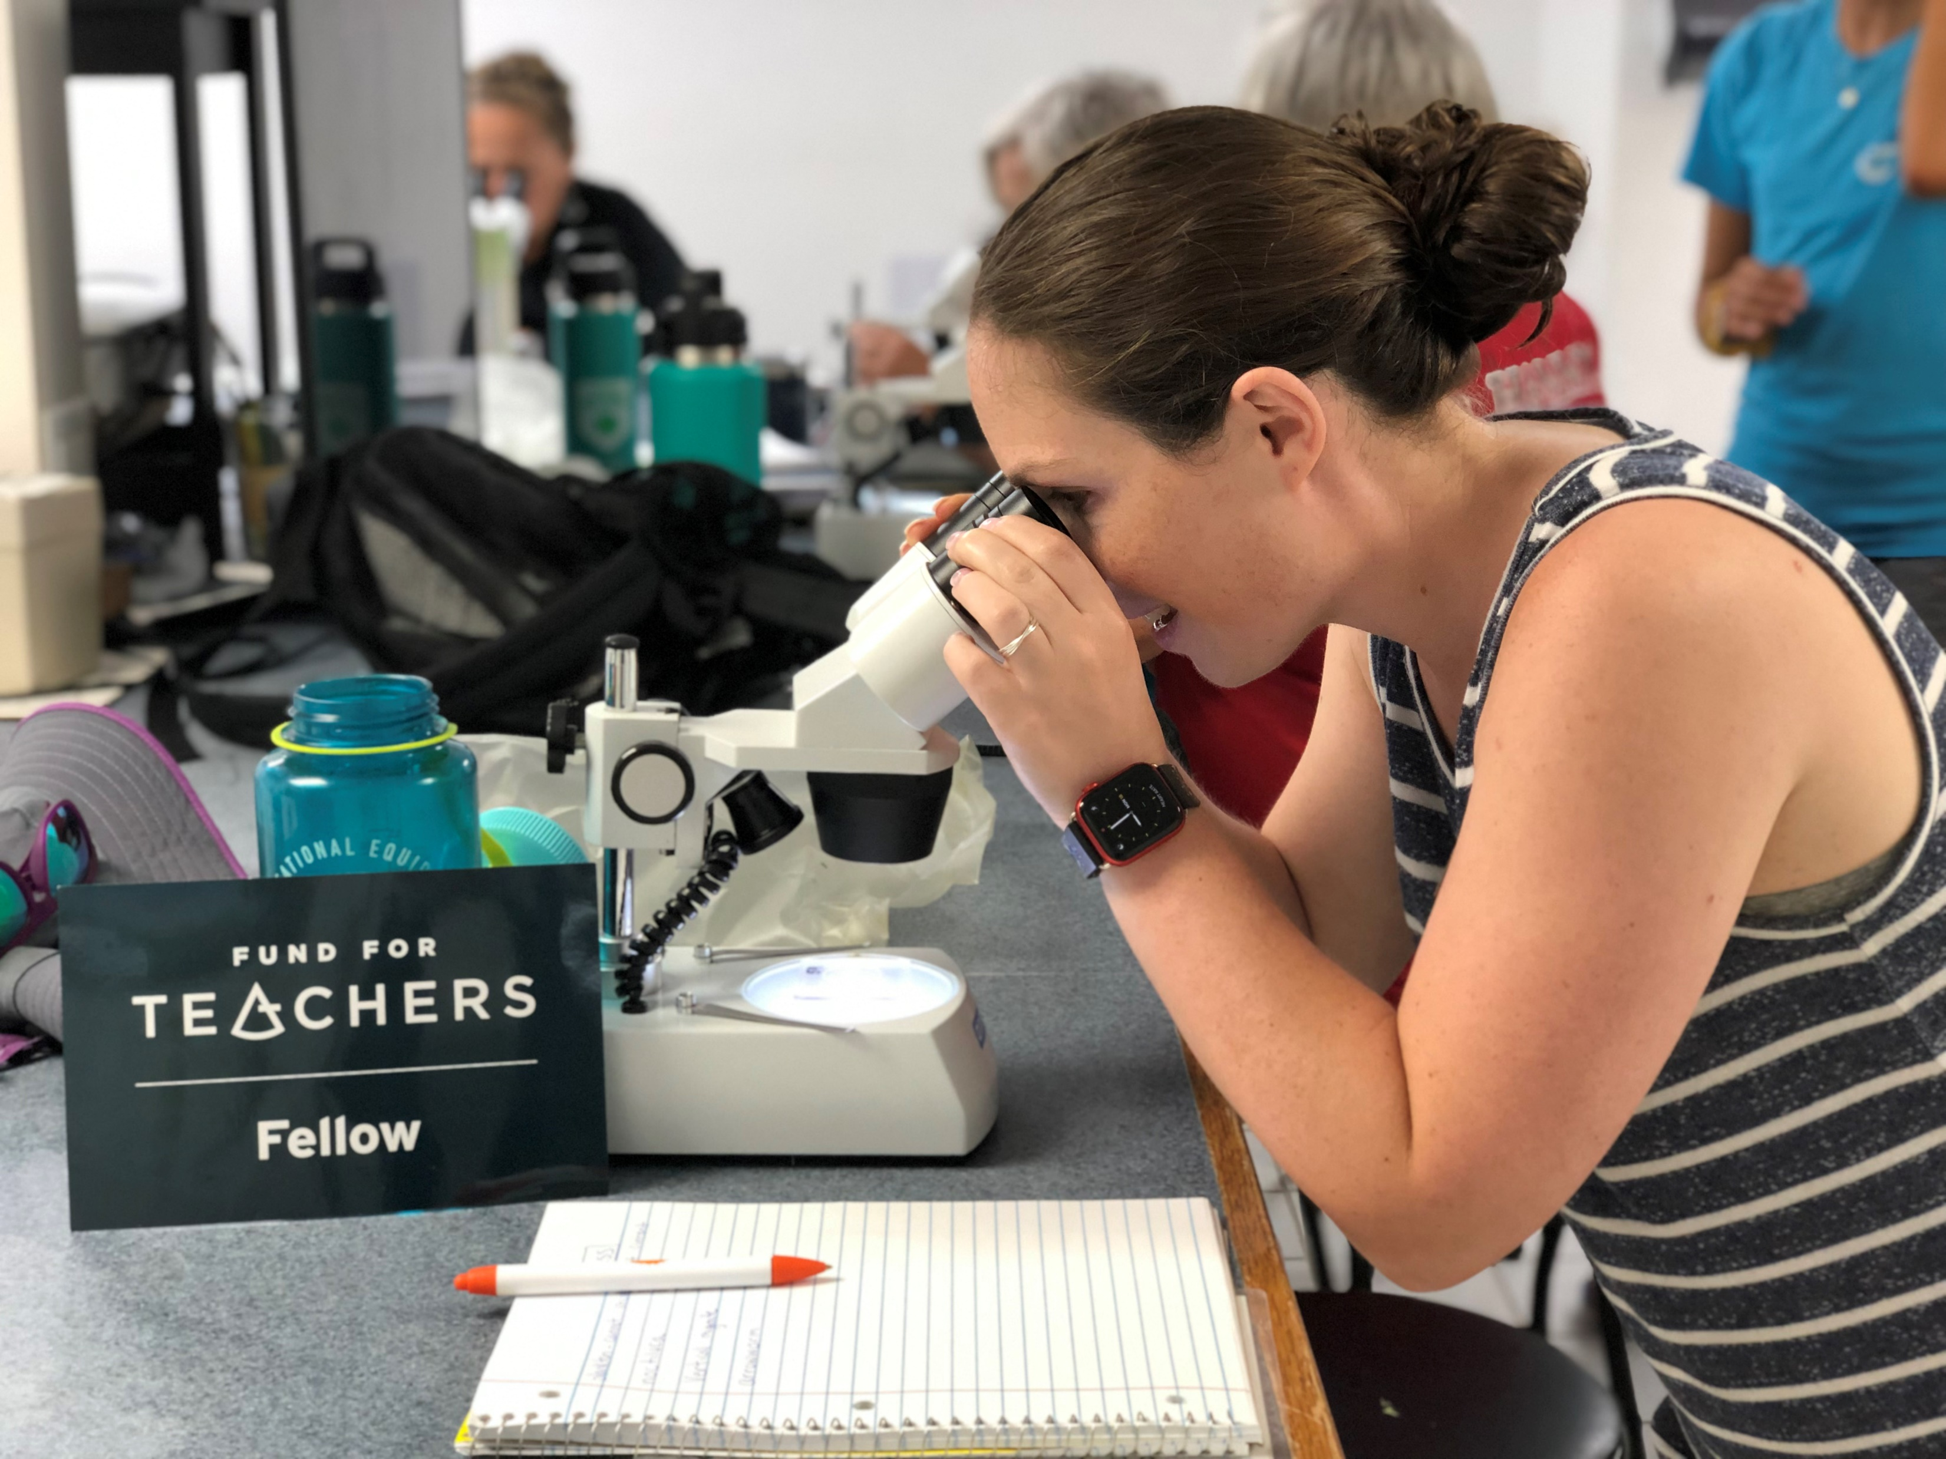
FELLOWSHIP PROPOSAL
Fellowship Purpose & Overarching Goals
Fellowship Plan
Teacher Growth and Learning
Student and Stakeholder Experience
Budget Narrative

Slide 10
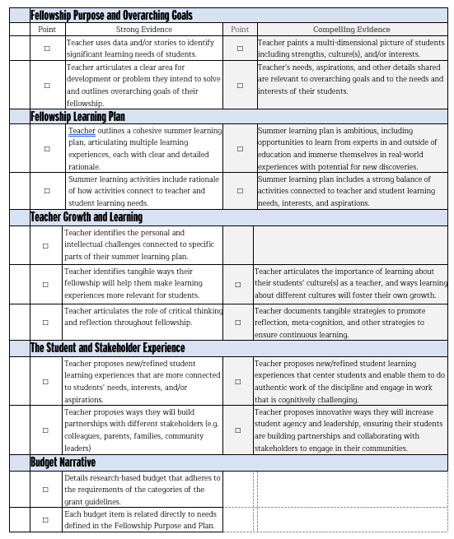
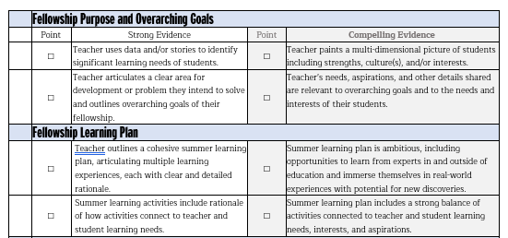
SCORING CRITERIA
Notes:
The scoring criteria is one of the most useful resources we provide—it’s kind of like an open book test. First and foremost, it outlines the kind of ideas we are looking for in an application, but also, it’s a tool for you to use to as you write and request help from others. Encourage applicants to give a copy of the Scoring Criteria with their proposal when seeking feedback.

Slide 11
GETTING STARTED
Fund for Teachers has prepared several resources to help you get started on the path to a successful grant proposal:
2
4
Read the Application Guidelines
Ask Others for Help
1
3
5
Visit the Online Learning Center
Download the Scoring Criteria
Go! Apply Online by January 18
All resources can be accessed from fundforteachers.org

Slide 12
GRANT WRITING TIPS
ASK FOR HELP
Details. Details.
Watch your tone.
Ask a peer, district grant coordinator or friend to read your proposal. Encourage them to use the FFT Scoring Criteria to rate your proposal as they read. If they encounter any weak sections, make changes and ask that they re-read and score it again.
Strong applications are explicit about why the project is important, doesn’t assume the reader knows anything about what they are learning or where they are going, and shows thorough research.
As you begin writing your proposal, remember that your tone is as important as your content. Selection committees want to choose teachers who demonstrate need and follow through with great action plans.
There is no spell or grammar check within the online application system. Our best advice: Compose your proposal in a Word document. It makes it much easier to proofread, share with peers, and finally just copy and paste into our online system.
Avoid using “edu-speak,” technical terminology or acronyms that may be unfamiliar to those outside of education.
Successful grant writing takes a considerable amount of time. Start early. Do your research before sitting down to write.
Take your time.
Proofread.
Junk the jargon.

Slide 13
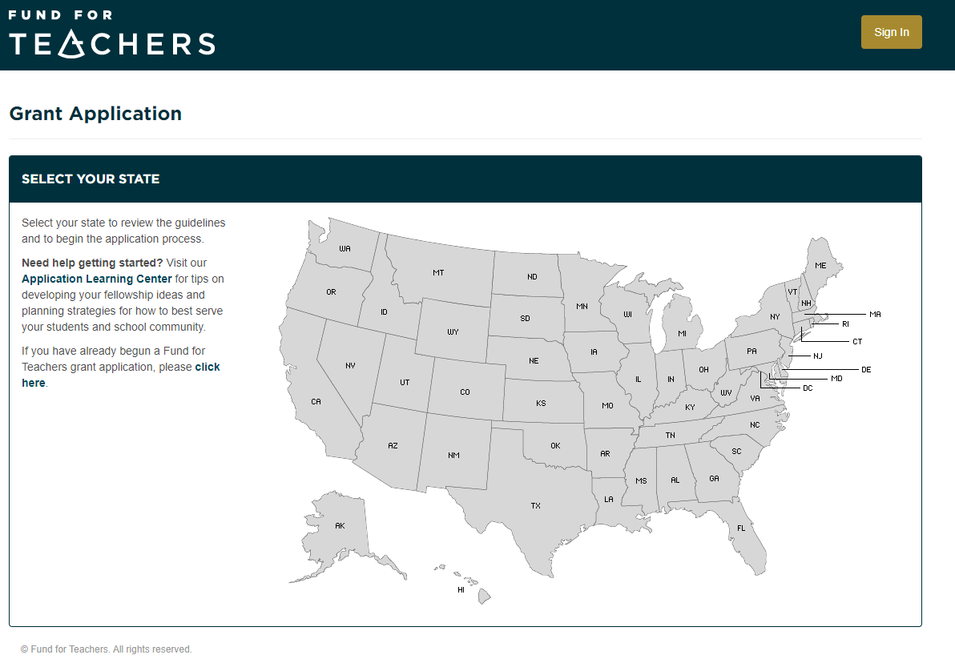
APPLY ONLINE
ALL ONLINE
Apply online at: fft.fundforteachers.org Application opens on October 1
DEADLINE
January 18, 2024, 5 pm CST
WORD PROCESSING
Compose your grant proposal in a word processing program first, then cut and paste your proposal into the online application.
NOTIFICATION
Applicants will be notified by email on April 4 the results of the Selection Committee's recommendations.
“My grant pushed me beyond what I thought I could do.”

Slide 14
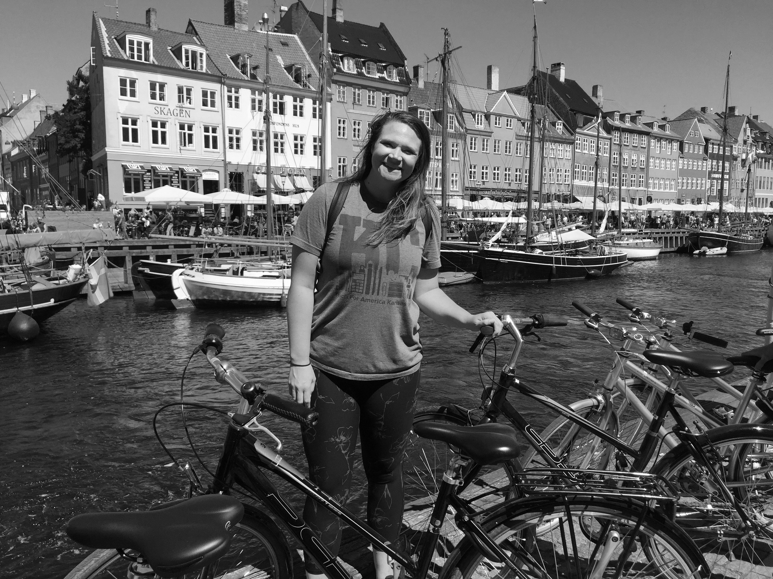
CONTACT US
Questions? We are here to help.
info@fundforteachers.org
<Your contact information>
1-800-681-2667
Fundforteachers.org

